Slide 1

PRESENTATION
BY POONAM

Slide 2


Slide 3
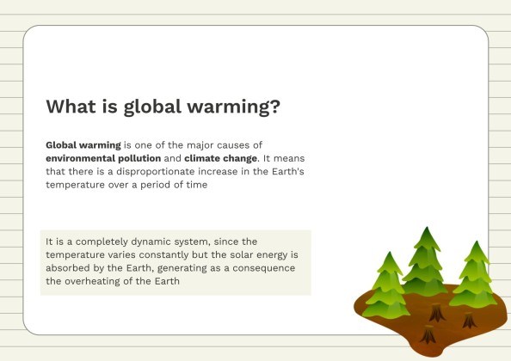

Slide 4
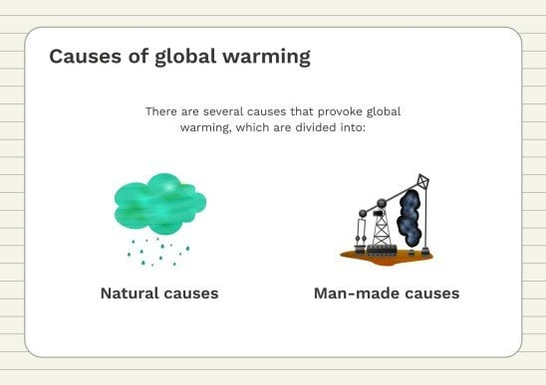

Slide 5
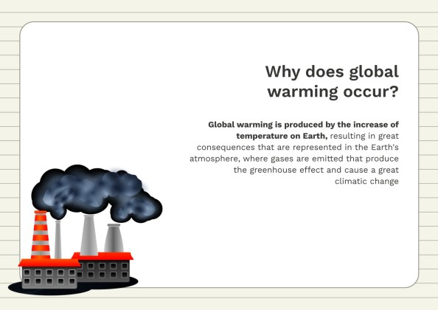

Slide 6
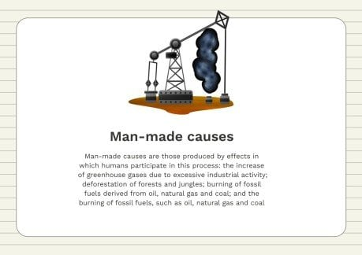

Slide 7
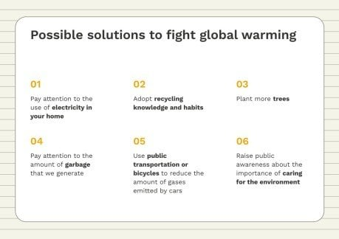

Slide 8

REDUCE WATER WASTE
Saving water reduces carbon pollution, too. That's because it takes a lot of energy to pump, heat, and treat your water. So take shorter showers, turn off the tap while brushing your teeth, and switch to Water Sense-labeled fixtures and appliances. The EPA estimates that if just one out of every 100 American homes were retrofitted with water-efficient fixtures, about 100 million kilowatt-hours of electricity per year would be saved—avoiding 80,000 warming pollution.

Slide 9
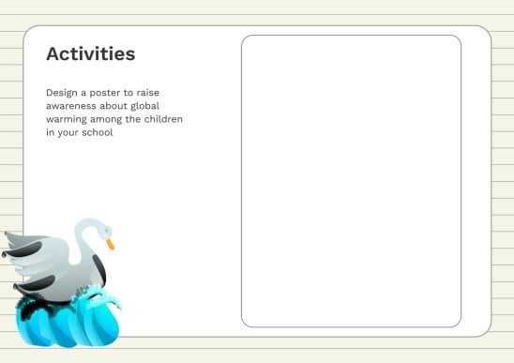

Slide 10
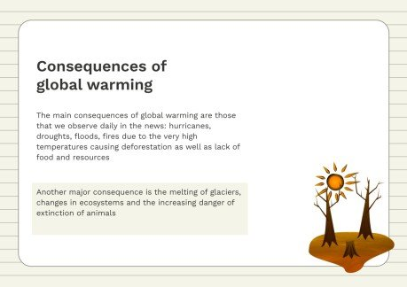

Slide 11
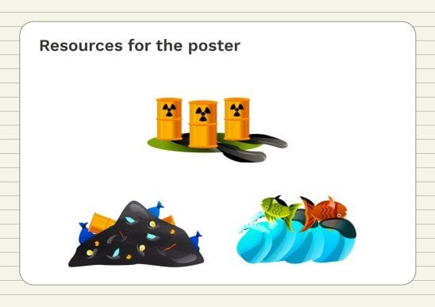

Slide 12
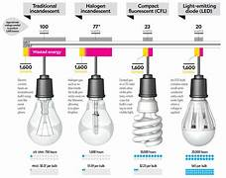
BUY BETTER BULB
LED Light Bulbs use one-sixth the amount of energy to deliver the same amount of light as conventional incandescents and last at least 10 times longer. They’re also cheaper in the long run: A 10-watt LED that replaces your traditional 60-watt bulb will save you $125 over the light bulb’s life. And because the average American home has around 40 to 50 light bulbs, this is a simple swap that will reap huge rewards. If every household in the United States replaced just one incandescent with an Energy Star–labeled LED, we would prevent seven billion pounds of carbon pollution per year. That’s equivalent to the emissions of about 648,000 cars.

Slide 13
